Slide 1
DEVELOPMENT SUPPORT TOOLS Eclerx Service Limited
Name: PRERNA BHATIA
Reg. No.: 11611526

Slide 2
About eClerx Service Limited
1.eClerx Digital: eClerx Digital is the trusted partner of choice to the world’s largest global brands for creative production, eCommerce, marketing, and analytics & insights services.
2.eClerx Financial Market: For financial organizations across the world, eClerx Markets, offers consulting, technological innovation, and process management expertise to uniquely solve operational challenges
3.eClerx Customer Operation: eClerx Customer Operations Product Manager dedicated to improving customer experience and operational efficiencies.
Internship Duration: 1 year
Location: Airoli, Mumbai

Slide 3




Web PageS TECHNOLIGIES

Slide 4


Slide 5
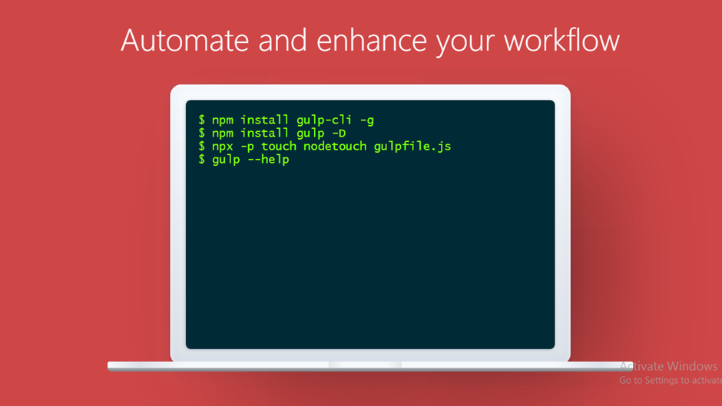

Gulp.JS
Gulp is a toolkit for automating tasks.
4,075 Gulp Plugins.
1000+ companies using Gulp.
Simple usage
Installation of Gulp.js

Slide 6
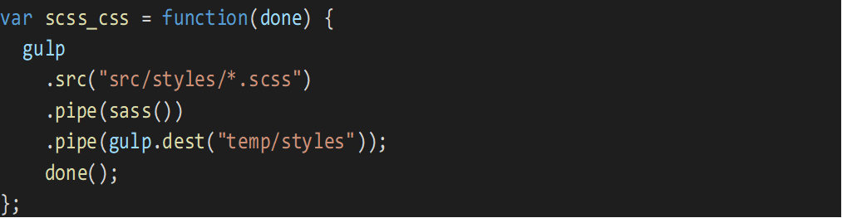
Gulp.JS PLUGINS
1.gulp-sass:
Gulp-sass is one of the famous plugin or package that used for converting the scss file to css file automatically using gulp.
Steps to use this plugin-
Step-1: First you need to install this package. We need use this command in node.js command prompt-
npm i gulp-sass
Step-2: To execute this plugin we need to have 1 or multiple scss file
Step-3: Code to execute-

Slide 7
GULP.JS PLUGIN
2. gulp-clean-css:
gulp-clean-css is one of the common plugin or package that used for minify the css files automatically using gulp by writing few lines of code.
Steps to use this plugin-
Step-1: Install the package or plugin using this command on node.js command prompt-
npm i gulp-clean-css
Step-2: To execute this plugin we need to have at least one css file.
Step-3: Code to execute-

Slide 8
GULP.JS PLUGIN
3.gulp.spritesmith:
gulp.spritesmith is one of the famous and important plugin for images. This plugin help us to collect all the images and make it spritesheet. It also helps to increase the performance of website also.
Steps to use this plugin-
Step-1: Install the package or plugin using this command on node.js command prompt-
npm i gulp.spritesmith
Step-2: To execute this plugin we need to have 1 or multiple css file.
Step-3: Need to provide the image name and css name that create by executing.
Step-4: Code to execute-

Slide 9
Plugins
gulp-concat-css
gulp-htmlmin
gulp-concat
gulp-template
gulp-imagemin

Slide 10



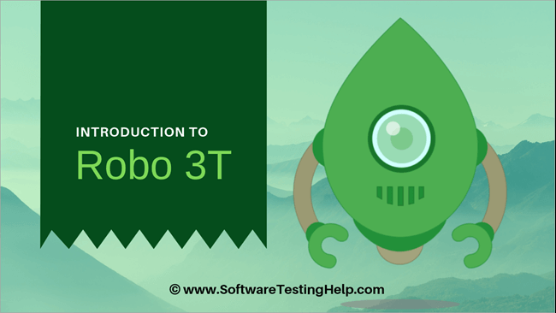
TECNOLOGIES USED TO MAKE api’S

Slide 11
PLUGINS USED TO MAKE REGISTER API
1.Koa
Koa is one of the main plugin which helps to create the server as same as apache.
Steps to use this plugin-
Step-1: We need to install this plugin. To install this plugin we need to write the command on node.js command prompt-
npm i koa
Step-2: After Install the plugin then we need to require on main that generally execute.

Slide 12
PLUGINS USED TO MAKE REGISTER API
2. koa-router-
koa-router plugin is used to route the API’s. It express the style routing using app.get, app.put, app.delete, app.post.
Steps to use this plugin-
Step-1: We need to install this plugin. To install this plugin we need to write the command on node.js command prompt-
npm i koa-router
Step-2: After Install the plugin then we need to require on main that generally execute.

Slide 13
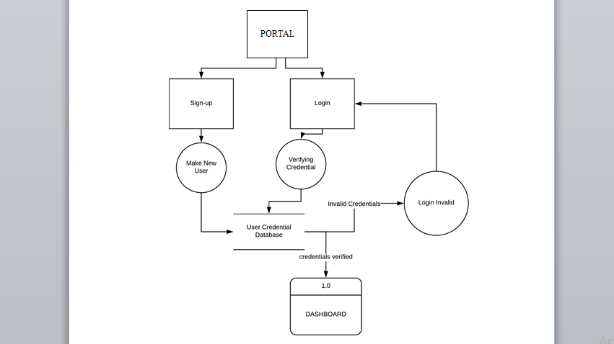
Login and Register Flow Chart

Slide 14
MongoDB PLUGINS
mongoose-
Mongoose is a MongoDB object modeling tool designed to work in an asynchronous environment. Mongoose supports both promises and callbacks.
Mongoose provide the schema property and model as well.
Steps to use this plugin-
Step-1: We need to install this plugin. To install this plugin we need to write the command on node.js command prompt-
npm i mongoose
Step-2: After Install the plugin then we need to require or write the code as well-

Slide 15
FUNCTIONS TO DEAL WITH DATABASE
1.db.collecton.save() Method-
Save method is used to insert the client information in database.
Code to Run-

Slide 16
FUNCTIONS TO DEAL WITH DATABASE
2.db.collection.findOne() Method-
Find method is used to read the data from database and check whether user exist or not.
Code to Run-

Slide 17
Thank You!

